Slide 1

Webpack

Slide 2
Webpack is a module bundler

Slide 3
What’s A Module Bundler?
In most programming languages you can separate your code into multiple files and import those files into your application to use the functionality contained in them.
This wasn’t built into browsers, so module bundlers were built to bring this capability in a couple forms: by asynchronously loading modules and running them when they have finished loading, or by combining all of the necessary files into a single JavaScript file that would be loaded via a <script> tag in the HTML.

Slide 4
Why bundle modules at all?

Slide 5
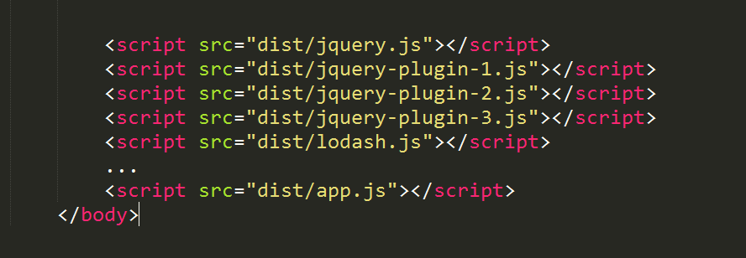
The “old” way
Notes:
Without the module loaders and bundlers, you could always combine your files manually or load your HTML with countless <script> tags, but that has several disadvantages:
- You need to keep track of the proper order in which the files should load, including which files depend on which other files and making sure not to include any files you don’t need.
- Multiple <script> tags means multiple calls to the server to load all of your code, which is worse for performance.
- Obviously, this entails a lot of manual work, instead of letting the computer do it for you.

Slide 6
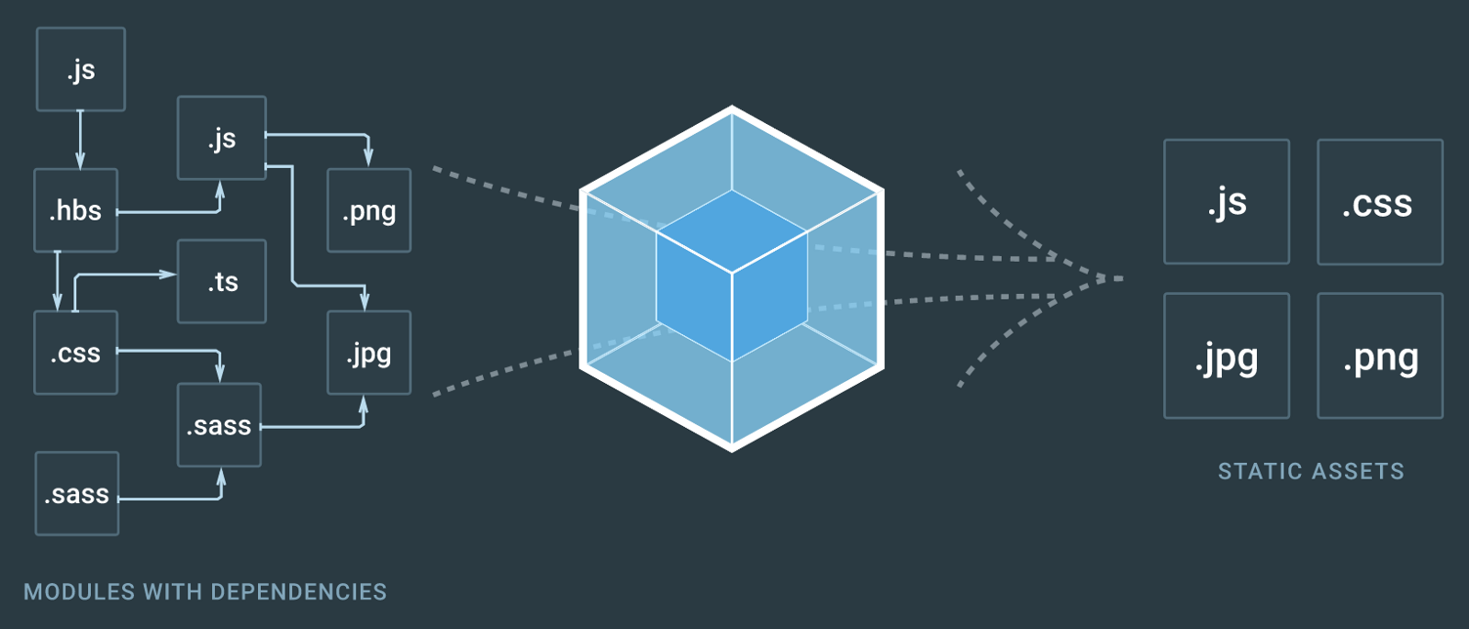
The Webpack way
Notes:
Webpack is a tool that lets you compile JavaScript modules.
Given a large number of files, it generates a single file (or a few files) that run your app.
This is a presenter notes

Slide 7
Webpack can perform operations like:
helps you bundle your resources.
watches for changes and re-runs the tasks.
can run Babel transpilation to ES5, allowing you to use the latest JavaScript features without worrying about browser support.
can transpile Typescript to JavaScript
can convert inline images to data URIs.
allows you to use require() for CSS files.
can run a development webserver.
can handle hot module replacement.
can split the output files into multiple files, to avoid having a huge js file to load in the first page hit.

Slide 8
Configuration
By default, webpack (starting from version 4) does not require any config if you respect these conventions:
the entry point of your app is ./src/index.js
the output is put in ./dist/main.js.
Webpack works in production mode
You can customize every little bit of webpack of course, when you need.
The webpack configuration is stored in the webpack.config.js file, in the project root folder.

Slide 9
Three main conepts
Entry points: The first JS code executed when a page is loaded. Dependencies are analyzed from this first module.
Loaders: Transformations on a resource file. Each module is loaded through a loader ☺
Plugins: Injects themselves into the build process to make all sort of crazy things.

Slide 10
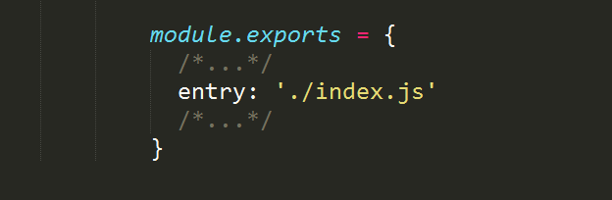
The entry point
By default the entry point is ./src/index.js
This simple example uses the ./index.js file as a starting point:
Notes:
You can define any other entry point or even several entry points to produce output

Slide 11
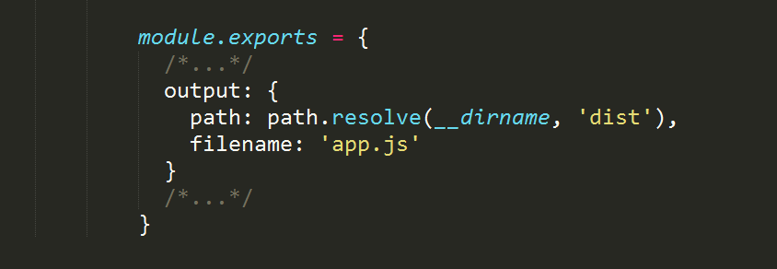
The output
By default the output is generated in ./dist/main.js.
This example puts the output bundle into app.js:

Slide 12
Loaders
Using webpack allows you to use import or require statements in your JavaScript code to not just include other JavaScript, but any kind of file, for example CSS.
Webpack aims to handle all our dependencies, not just JavaScript, and loaders are one way to do that.

Slide 13
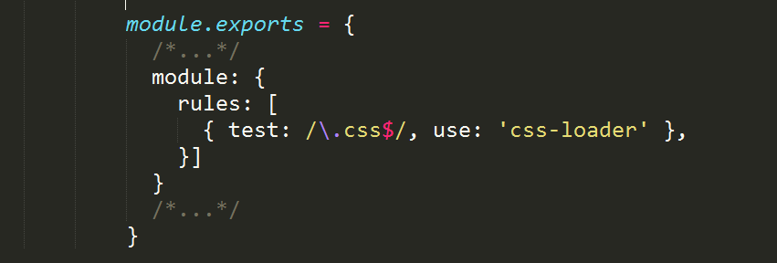
For example, in your code you can use:
import 'style.css'
by using this loader configuration:
The regular expression targets any CSS file.
Notes:
In this example, css-loader interprets the import 'style.css' directive in the CSS. style-loader is then responsible for injecting that CSS in the DOM, using a <style> tag.

Slide 14
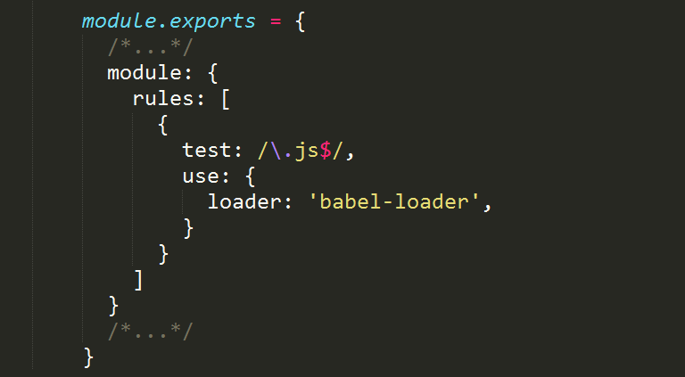
A commonly used loader is Babel,
which is used to transpile modern JavaScript to ES5 code:

Slide 15
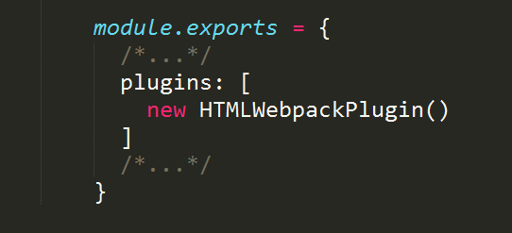
Plugins
Plugins are like loaders, but on steroids. They can do things that loaders can’t do, and they are one of the main building blocks of webpack.
Take this example:
The HTMLWebpackPlugin plugin has the job of automatically creating an HTML file, adding to the output JS bundle path, so the JavaScript is ready to be served.

Slide 16
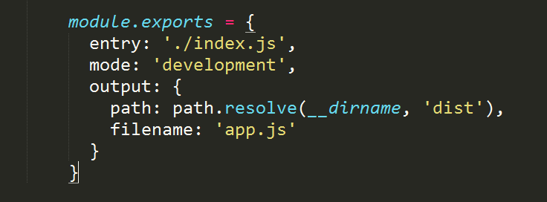
The webpack mode
This mode (introduced in webpack 4) sets the environment on which webpack works.
It can be set to development or production
(defaults to production, so you only set it when moving to development)
Notes:
Development mode:
builds very fast
is less optimized than production
does not remove comments
provides more detailed error messages and suggestions
provides a better debugging experience
Production mode is slower to build, since it needs to generate a more optimized bundle. The resulting JavaScript file is smaller in size, as it removes many things that are not needed in production.

Slide 17
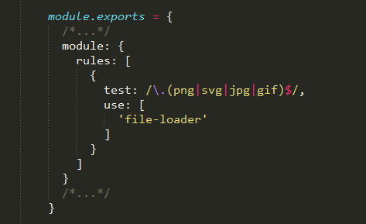
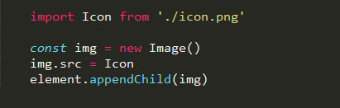
Handling images
Webpack allows us to use images in a very convenient way, using the file-loader loader.
This simple configuration:
Allows you to import images in your JavaScript:
Notes:
file-loader can handle other asset types as well, like fonts, CSV files, xml, and more.

Slide 18
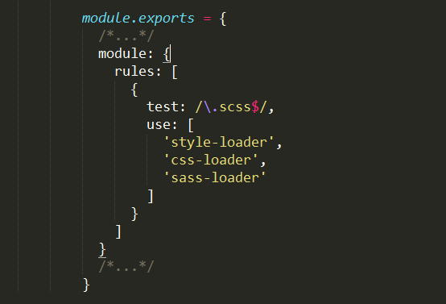
Process and transform SASS code to CSS
Using sass-loader, css-loader and style-loader:
Notes:
SASS (Syntactically Awesome StyleSheets) is an extension of CSS. SASS allows you to usefeatures like nested rules, variables, mixins, selector inheritance, and more.
Style Loader - Adds CSS to the DOM by injecting
The css-loader interprets @import and url() like import/require() and will resolve them.a <style> tag
Sass-loader Loads a Sass/SCSS file and compiles it to CSS.

Slide 19
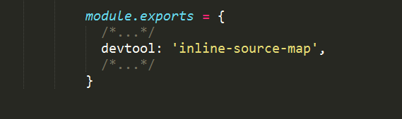
Generate source maps
Since webpack bundles the code, Source Maps are mandatory to get a reference to the original file that raised an error, for example.
You tell webpack to generate source maps using the devtool property of the configuration:
Notes:
devtool has many possible values, the most used probably are:
none: adds no source maps
source-map: ideal for production, provides a separate source map that can be minimized, and adds a reference into the bundle, so development tools know that the source map is available. Of course you should configure the server to avoid shipping this, and just use it for debugging purposes
inline-source-map: ideal for development, inlines the source map as a Data URL

Slide 20
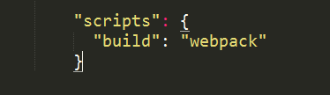

Running webpack
Webpack can be run from the command line manually if installed globally, but generally you write a script inside the package.json file, which is then run using npm or yarn.
For example this package.json scripts definition:
allows us to run webpack by running
or

Slide 21
What is npm?
In brief, npm is a package manager for JavaScript. It stands for Node Package Manager.
The official documentation explains that npm is three different things:
The website
The npm registry
The npm client
The website is a place where you can browse packages, read the docs, and find general info on npm.
The registry is a database that holds the information and the code for the packages.
The npm client is a tool installed on a developer’s machine that allows you to publish packages, install packages, and update packages.

Slide 22
What is yarn?
Yarn is a JavaScript Package Manager, a direct competitor of npm, and it’s one of the Facebook Open Source projects.
It’s compatible with npm packages, so it has the great advantage of being a drop-in replacement for npm.
When it launched it used to be way faster than npm due to parallel download and caching, but now npm did catch up with many of its features.
Tools eventually converge to a set of features that keeps them on the same level to stay relevant, so we’ll likely see those features in npm in the future.
So this competition is nice for us users.

Slide 23
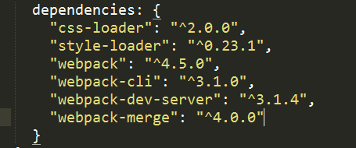
Managing packages
Yarn writes its dependencies to a file named package.json.
Which sits in the root folder of your project, and stores the dependencies files into the node_modules folder.
Notes:
That means that all dependencies required by webpack like loaders and plugins can be installed via Yarn, including webpack themself

Slide 24
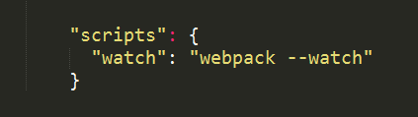

Watching changes
Webpack can automatically rebuild the bundle when a change in your app happens, and keep listening for the next change.
Just add this script to you package.json:
and run
or
Notes:
One nice feature of the watch mode is that the bundle is only changed if the build has no errors. If there are errors, watch will keep listening for changes, and try to rebuild the bundle, but the current, working bundle is not affected by those problematic builds.

Slide 25
Webpack in action: create-react-app
This package allows you to create React apps with no build configuration.
Run following command to start using it:
Navigate to http://localhost:3000
Notes:
Your environment will have everything you need to build a modern single-page React app:
React, JSX, ES6, TypeScript and Flow syntax support.
Language extras beyond ES6 like the object spread operator.
Autoprefixed CSS, so you don’t need -webkit- or other prefixes.
A fast interactive unit test runner with built-in support for coverage reporting.
A live development server that warns about common mistakes.
A build script to bundle JS, CSS, and images for production, with hashes and sourcemaps.
An offline-first service worker and a web app manifest, meeting all the Progressive Web App criteria. (Note: Using the service worker is opt-in as of react-scripts@2.0.0 and higher)
Hassle-free updates for the above tools with a single dependency.

